Slide 1
Global Data Science Salaries:
Navigating Wide Ranges and Remote Work Considerations to Attract Top Talent in a Competitive Market
A visual analysis of
Salary Distribution: U.S.A. versus Offshore
Average Salary by Experience Level: U.S.A. versus Offshore
Salary versus Remote Work Ratio
Prepared by: Geoffrey Bruder

Slide 2
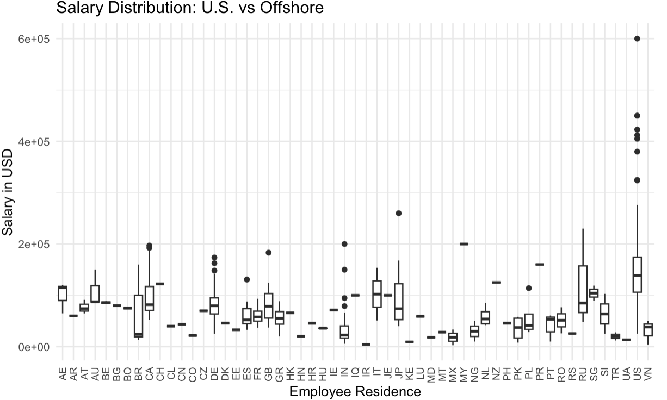
There is a wide variation in salary distributions across different residences.
Some residences have higher median salaries compared to others.
The U.S. shows a relatively high median salary and a wide range of salaries, including several outliers.
Other countries also show significant variations, with some having more outliers indicating higher salaries.
Disparities in salary distributions could be influenced by factors such as cost of living, demand for skills, and economic conditions in different regions.
Nonetheless, as tool for analyzing and understanding global salary trends, this visualization provides a clear comparison of salary distributions across various employee residences.
X-axis: Employee Residence (various country codes)
Y-axis: Salary in USD (ranging from 0 to 600,000 USD)
Boxes: Represent the interquartile range (IQR), which contains the middle 50% of the data.
Horizontal Line Inside the Box: Represents the median salary for that residence.
Whiskers: Extend from the boxes to the smallest and largest values within 1.5 times the IQR from the quartiles.
Dots: Represent outliers, which are data points outside the whiskers.

Slide 3
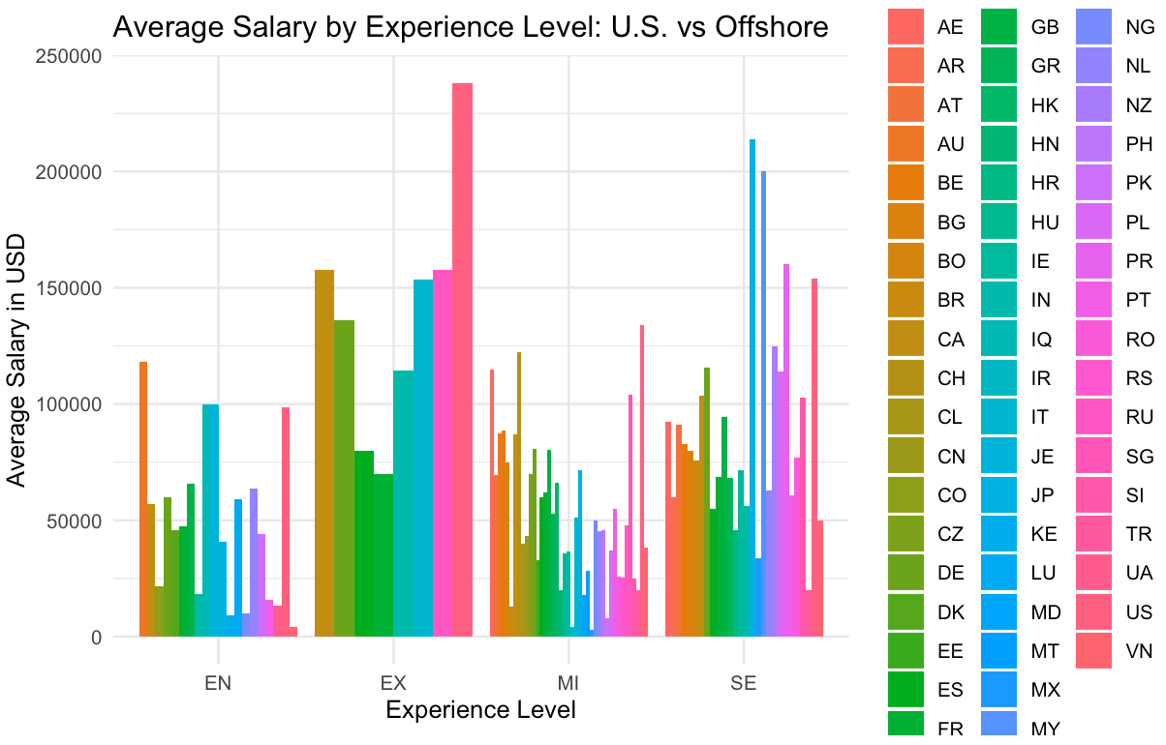
X-Axis: Experience Level (with categories: Entry Level, Mid-Level, Senior Level, Executive Level)
Y-Axis: Average Salary in USD
The bar graph provides a clear visual comparison of average salaries for different experience levels across U.S. and Offshore locations.
U.S.-based employees have higher average salaries compared to their offshore counterparts across all experience levels.
This highlights potential salary gaps and can inform strategic decisions regarding competitive compensation offers by emphasizing the importance of considering geographic location and experience level in salary planning.

Slide 4
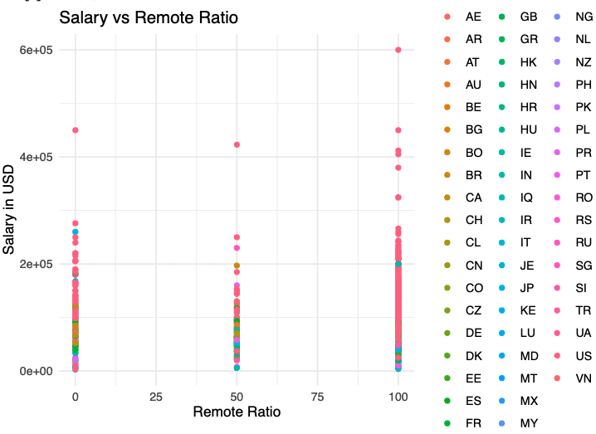
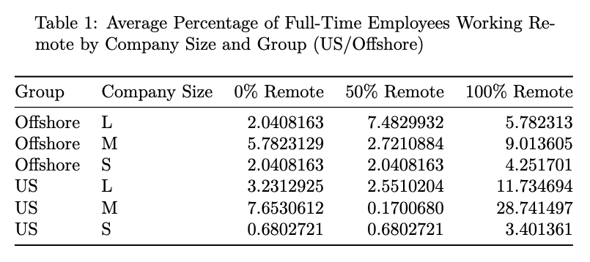
Remote work trends across different company sizes and geographical locations highlight the variations in the adoption of remote work between large, medium, and small companies in the US and Offshore.
The data indicates that US companies, especially medium-sized ones, have a higher percentage of full-time employees working remotely compared to Offshore companies.
X-Axis (Remote Ratio): This axis represents the percentage of work that employees perform remotely, ranging from 0% (fully on-site) to 100% (fully remote).
Y-Axis (Salary in USD): This axis shows the salaries of the employees, measured in US dollars.
Color (Employee Residence): Each color represents a different country where the employees reside.
The scatter plot represents the relationship between salary in USD and remote work ratio for employees from different countries, emphasizing the salary distribution.
Salaries vary widely across all remote ratios.
Some employees in the fully remote category (100% remote ratio) are earning higher salaries, indicating that remote work may be associated with more competitive compensation for certain roles in in certain regions.

Slide 5
Strategic Salary Recommendations:
Balancing U.S. and Offshore Data Science Compensation in a Competitive Market
Based on analysis of the data provided:
For U.S.-based data scientists,
the average salary is around $148297.09 USD,
while offshore data scientists have an average
salary of approximately $69529.92 USD.
To attract top talent, especially in a competitive market,
consider offering salaries at or above these averages
depending on the candidate's experience and expertise.
Considering a notable relationship between the remote
work ratio and salary distribution for employees across
different countries, as well as, current trends in the
influence of remote work on hiring salary, more
competitive compensation may be necessary for roles
allowing full remote work.
These considerations may help set competitive salaries
based on average salaries, remote work ratios,
and geographical locations. They also serve to inform decisions
about remote work policies and assist in developing
guidelines and policies that support fair compensation
practices.
More information. R markdown & dataset for this analysis are located @:
https://github.com/proj-post/dse5002_bruder_module05_project01.git

